Slide 1
Stacking ensemble model of deep learning for plant disease recognition
Mohammad Rakibul Hasan Mahin (20201220)
Md. Shamsul Rayhan Chy (19201109)

Slide 2
Introduction
Identification of plant disease is important.
Damage caused by Plant Disease is rapidly growing.
Still very old method is used for disease detection

Slide 3
Use of AI in Plant Leaf Disease Identification
More efficient
Use of SVM to classify 3 types of Soybean leaf disease
Identification of Cotton and Tomato disease using Artificial Neural Network
Better Techniques are introduced
Use of Generative Adversarial Network
Deployment Issue

Slide 4
Dataset
Images collected on an on-field cultivation farm environment
Around 1000 images
2 different classes
Backdrop conditions
Background problem
Objects on sight
Lighting Condition
Resized Image
Different Classes
Use of Other datasets:
Plant Village
AI Challenger
Sethy

Slide 5
Proposed Model
Using convolutional ensemble learning
3 lightweight CNN used
SE-MobileNet
Mobile-DANet
MobileNet V2
3 main Ensemble Learning Strategies
Bagging
Boosting
Stacking
Two level stacking strategy used
Transfer Learning and Two-Stage training strategy used

Slide 6
Algorithm
Feature Extraction
Construction of a base classifier
Construction of Probability feature space and training of SoftMax classification
Use of:
Global Average Pooling
Dropout
Batch Normalization
Sigmoid Layer
Adam Optimizer
Learning rate of 0.001 used
100 epochs

Slide 7
Experimental Analysis
Result on Open Database
Some of the images from Plant Village was taken to evaluate the model
Other well known CNN’s are also considered for evaluation
Performance measured using:
Accuracy (TP+TN) / (TN+TP+FN+FP’)
Recall TP / (TP+FN’)
F1 Score 2TP / (2TP+FN+FP’)

Slide 8
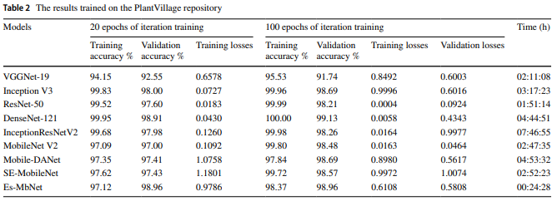
Result Comparison with well known CNN’s

Slide 9
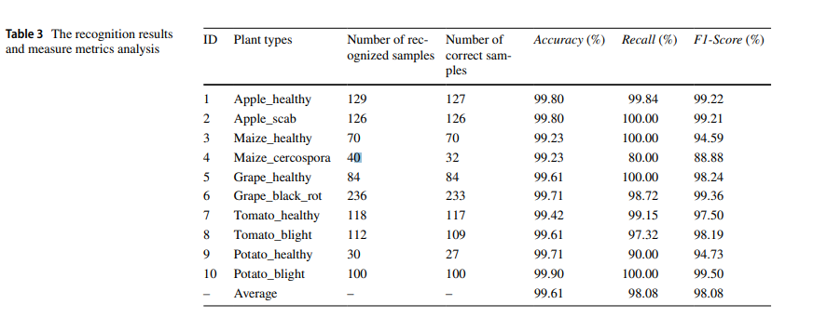
Recognition Results and Measure Metrics Analysis

Slide 10
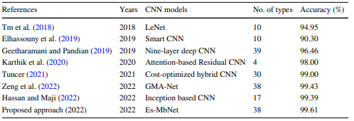
Result Comparison with Other works

Slide 11
Experiment on Local Dataset
Produce new synthetic images for model training
Alleviates the risk of over-fitting
DCGAN method to generate diverse images automatically
Mini-batch size is 16
Learning rate of 1x10^-4
Epochs 5x10^5
200 images per category

Slide 12
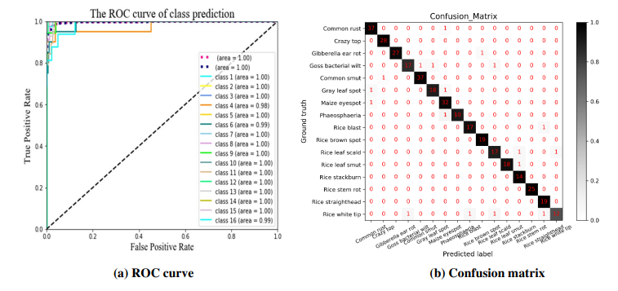
ROC Curve and Confusion Matrix

Slide 13
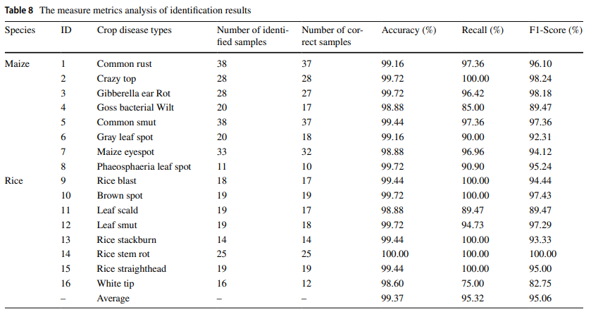
Measure Metrics Analysis of Identification Results

Slide 14
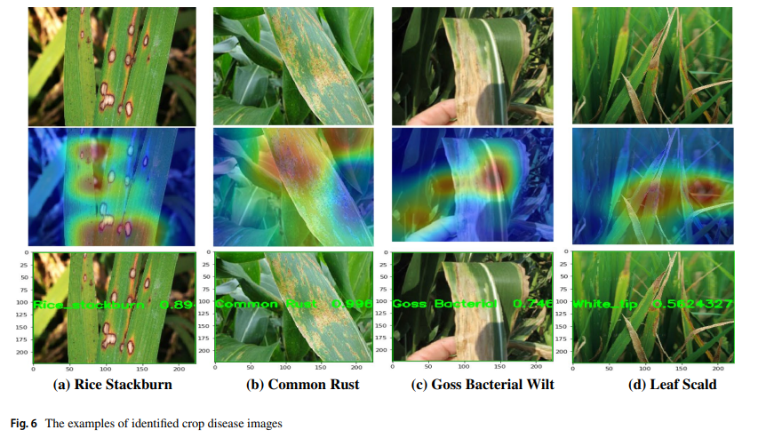
Examples of Identified Crop Disease Images

Slide 15
Conclusion
Efficient recognition of plant disease
Novel Convolutional Ensemble Learning Method
Three lightweight networks
Model training has two stage training strategy

